Slide 2
Paul J. Miller, CEBS
pmiller@usebsg.com
(610) 246-2729
LinkedIn: https://www.linkedin.com/in/pauljmiller/
U.S. Employee Benefits Services Group is a leading national employee benefits broker/consultant
Services include:
Employee Benefit Optimization
HR Compliance Services
Online Benefit Enrollment and Administration Solutions
Community Involvement Employee Engagement Programs
Paul Miller has over 30 years of experience in the employee benefits industry working with employers of all sizes and industries. He has twice served as President of the Greater Philadelphia Chapter of the International Society of Certified Employee Benefits Specialists (ISCEBS).

Slide 3
OUR AGENDA
01
Introduction
Coronavirus 2020
Compliance, HR Concerns & Employee Leaves of Absence
02
Legislation
03
Leaves of Absence
04
Guidance
05
Reopening
06
Rehiring

Slide 4
Angie Surra, VP of Compliance
Broker and Consultant with 20+ years experience
National Speaker and Educator
Licensed in Life, Health and Annuities
Licensed in Property and Casualty Insurance
Certified Insurance Counselor
Certified Professional Compliance Advisor
SHRM Certified Professional
Member of Health Agents for America (HAFA)
NavigateHCR (NHCR) is a full-service compliance consulting company that offers a variety of services to assist employers and brokers with even the most complex requirements of laws governing employee benefits.

Slide 5
COVID-19 Legislation
FFCRA and CARES
On March 18, 2020, the Families First Coronavirus Response Act was signed into law, marking the second major legislative initiative to address COVID-19 (the first was signed on March 6 and provided emergency funding relief for domestic and global efforts).
On March 27,2020, the Coronavirus Aid, Relief, and Economic Security (CARES) Act that was passed by Congress to assist business owners with the needs and funding they have right now.
The content in this presentation is only as accurate as the source materials pulled from prior to the date the presentation was given. No distribution of the material is permitted without expressed written consent by USEBSG. This material is not intended to provide specific legal, tax, or other professional advice.

Slide 6
Emergency Paid Sick Leave
Families First Coronavirus Response Act
Two weeks (10 days)
No length of employment requirement
Effective 4/1/2020 through 12/31/2020
To eligible employees who cannot work or telework due to:
Employee is subject to Federal, State or local quarantine or isolation related to COVID-19
Employee has been advised by healthcare provider to self-quarantine due to concerns related to COVID-19
Employee is experiencing symptoms of coronavirus and seeking medical diagnosis
Items 1 – 3 are at regular rate, capped at $511/day or $5110/aggregate
To care for an individual who is in quarantine or isolation pursuant to Federal, State or local order related to COVID-19 or pursuant to advice of a healthcare provider due to concerns related to coronavirus
To care for employee’s child if child’s school or place of care has been closed, or the childcare provider is unavailable due to COVID-19 precautions
Employee is experiencing any other substantially similar condition specified by Secretary of Health Services in consultation with Secretary of Treasury and Secretary of Labor
Items 4 - 6 are at 2/3 of regular rate, capped at $200/day or $2000/aggregate
The content in this presentation is only as accurate as the source materials pulled from prior to the date the presentation was given. No distribution of the material is permitted without expressed written consent by USEBSG. This material is not intended to provide specific legal, tax, or other professional advice.

Slide 7
Emergency FMLA Expansion
Families First Coronavirus Response Act
Up to 12 weeks (does not lengthen FMLA)
Effective 4/1/2020 through 12/31/2020
To eligible employees (worked 30 days) that cannot work or telework because the employee has to care for the employee’s minor (under 18) child whose school or place of care has been closed, or whose child care provider is unavailable due to an emergency declared by a Federal, State, or local authority regarding COVID-19.
First 10 days are unpaid, but employee may use any accrued leave.
After first 10 days, remaining leave paid at no less than 2/3rds of employee’s regular rate (capped at $200 per day or $10,000 total)
The content in this presentation is only as accurate as the source materials pulled from prior to the date the presentation was given. No distribution of the material is permitted without expressed written consent by USEBSG. This material is not intended to provide specific legal, tax, or other professional advice.

Slide 8
Tax Credits
Families First Coronavirus Response Act
Tax Credits
Emergency paid sick leave tax credits will be fully federally funded
Up to the maximums listed by reason
Quarterly payroll tax credit (will exclude the value of leave paid on 941)
Not available for employers receiving a credit for paid FMLA under Tax Cut and Jobs Act
The content in this presentation is only as accurate as the source materials pulled from prior to the date the presentation was given. No distribution of the material is permitted without expressed written consent by USEBSG. This material is not intended to provide specific legal, tax, or other professional advice.

Slide 9
Guidance on FFCRA Details
Under 500 Employees
You have fewer than 500 employees if, at the time your employee’s leave is to be taken, you employ fewer than 500 full-time and part-time employees within the United States, which includes any State of the United States, the District of Columbia, or any Territory or possession of the United States. In making this determination, you should include employees on leave; temporary employees who are jointly employed by you and another employer (regardless of whether the jointly-employed employees are maintained on only your or another employer’s payroll); and day laborers supplied by a temporary agency (regardless of whether you are the temporary agency or the client firm if there is a continuing employment relationship). Workers who are independent contractors under the Fair Labor Standards Act (FLSA), rather than employees, are not considered employees for purposes of the 500-employee threshold.
30-day rule for FMLA Expansion
Employee had been on payroll (in any capacity) for the 30 calendar days immediately prior to the day your leave would begin.
For example, if you want to take leave on April 1, 2020, you would need to have been on your employer’s payroll as of March 2, 2020.
The content in this presentation is only as accurate as the source materials pulled from prior to the date the presentation was given. No distribution of the material is permitted without expressed written consent by USEBSG. This material is not intended to provide specific legal, tax, or other professional advice.

Slide 10
Guidance on FFCRA Details
Who is an “individual” that an employee requests EPSL to care for?
an immediate family member,
a person who regularly resides in the employee’s home or
a person with whom the employee has a relationship that creates an expectation that the employee would care for the person if he or she were quarantined or self-quarantined.
When an employee notifies his/her employer of the need to take leave due to the closure of a child’s school or unavailability of a childcare provider, the employer must verify that:
the child(ren) in question meet the Rule’s definition;
the employee attests that no other suitable person is available to care for the son or daughter during the requested period of leave; and
the employee isn’t able to telework and perform such work that the employer has available.
The content in this presentation is only as accurate as the source materials pulled from prior to the date the presentation was given. No distribution of the material is permitted without expressed written consent by USEBSG. This material is not intended to provide specific legal, tax, or other professional advice.

Slide 11
Guidance on FFCRA Details
How much to pay each employee
Base pay, commissions, tips, piece rates are incorporated into calculation
The act requires you to pay an employee for hours the employee would have been normally scheduled to work even if that is more than 40 hours in a week.
The act requires that paid sick leave be paid only up to 80 hours over a two-week period. For example, an employee who is scheduled to work 50 hours a week may take 50 hours of paid sick leave in the first week and 30 hours of paid sick leave in the second week. In any event, the total number of hours paid under the Emergency Paid Sick Leave Act is capped at 80.
Sick: $200 / $2000 or $511 / $5110
FMLA: $12,000 Total
The content in this presentation is only as accurate as the source materials pulled from prior to the date the presentation was given. No distribution of the material is permitted without expressed written consent by USEBSG. This material is not intended to provide specific legal, tax, or other professional advice.

Slide 14
EPSL & EFMLA
Employer Responsibilities
What can an employer request the employee provide to take EPSL & EFMLA?
The employee’s name, date(s) for which leave is requested, and the qualifying reason for the leave.
The name of the government entity that issued the COVID-19-related quarantine or isolation order that applies to the employee; or
The name of the health care provider who advised the employee to self-quarantine due to COVID-19-related concerns; or
The name of the government entity that issued the quarantine or isolation order for the person being cared for and the name of the person who is being cared for and the relationship to the employee; or
The name of the healthcare provider who advised the individual being cared for to self-quarantine (if taking EPSL to care of another person) and the name of the person who is being cared for and the relationship to the employee.
the name of the son or daughter being cared for, the son or daughter’s age, and the name of the son or daughter’s school, place of care or childcare provider that is closed or unavailable due to coronavirus-related reasons.

Slide 15
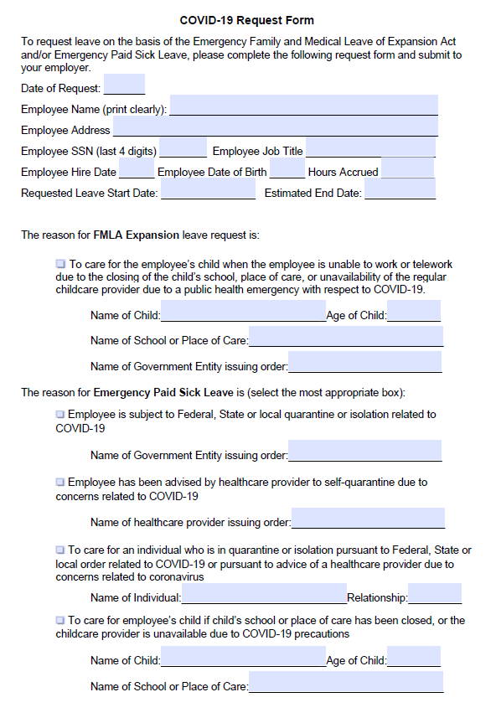
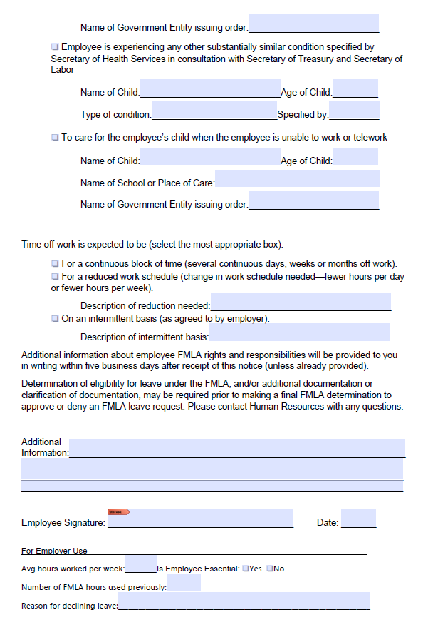

Slide 16
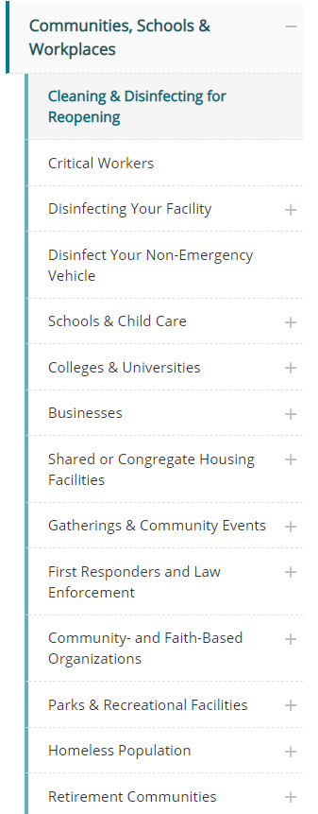
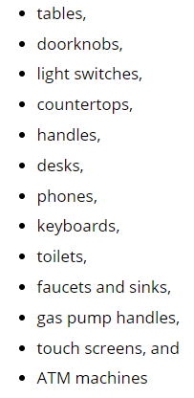
Reopening
Prepare to reopen
All products on this list meet EPA’s criteria for use against SARS-CoV-2, the virus that causes COVID-19.
Tips for preparing to reopen your business
Safety measures – OSHA3990
Cleaning and screening
Barriers between people
Employee access to soap, sanitizer, face masks
Communications to employees and patrons
Employee return to work rules and guidance
Shift work, telework, physical distancing measures
Education and guidance to employees
Regular check-ins with employees
https://www.cdc.gov/coronavirus/2019-ncov/community/reopen-guidance.html

Slide 17
Reopening
Prepare to reopen
All products on this list meet EPA’s criteria for use against SARS-CoV-2, the virus that causes COVID-19.
Tips for preparing to reopen your business
Safety measures – OSHA3990
Cleaning and screening
Barriers between people
Employee access to soap, sanitizer, face masks
Communications to employees and patrons
Employee return to work rules and guidance
Shift work, telework, physical distancing measures
Education and guidance to employees
Regular check-ins with employees
https://www.cdc.gov/coronavirus/2019-ncov/community/reopen-guidance.html
https://www.governor.pa.gov/wp-content/uploads/2020/05/20200504-COVID-19-Business-Guidance.pdf
The content in this presentation is only as accurate as the source materials pulled from prior to the date the presentation was given. No distribution of the material is permitted without expressed written consent by USEBSG. This material is not intended to provide specific legal, tax, or other professional advice.

Slide 18
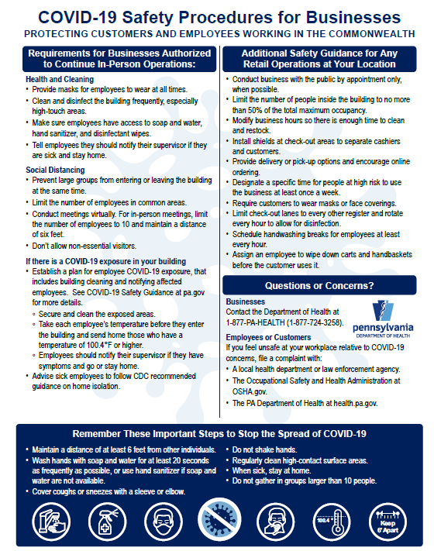
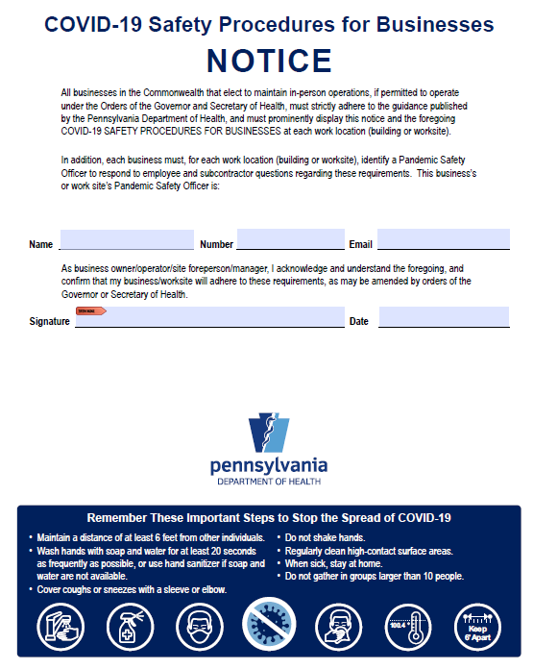
https://www.pa.gov/wp-content/uploads/2020/04/COVID-19-Reopening-Businesses-Flyer-8-5x11-1.pdf

Slide 19
Rehiring
Resources for bringing employees back to work
Prepare for rehiring and bringing back your employees
Updated I-9, W-4, Direct Deposit and emergency contact forms
Employee handbook and sign-off as received
Job descriptions
Drug testing (if applicable)
Benefit enrollment forms
SPD, SBC, Uniform Glossary, Privacy Notice, COBRA Initial Notice, FMLA Poster, CHIP Notice, NMHPA Notice, WHCRA Notice, etc.
The content in this presentation is only as accurate as the source materials pulled from prior to the date the presentation was given. No distribution of the material is permitted without expressed written consent by USEBSG. This material is not intended to provide specific legal, tax, or other professional advice.

Slide 20
Please feel free to contact Paul Miller with any follow up questions regarding HR compliance or any other employee benefit related matter!
Alert: Early indications regarding upcoming health benefit renewals are that you should plan for the possibility of significant rate increases.
Contact Paul Miller
Pmiller@usebsg.com
(610) 246-2729
LinkedIn https://www.linkedin.com/in/pauljmiller/
Angie@NavigateHCR.com
www.USEBSG.com
www.NavigateHCR.com

Slide 21
Thank you for attending

